Slide 1

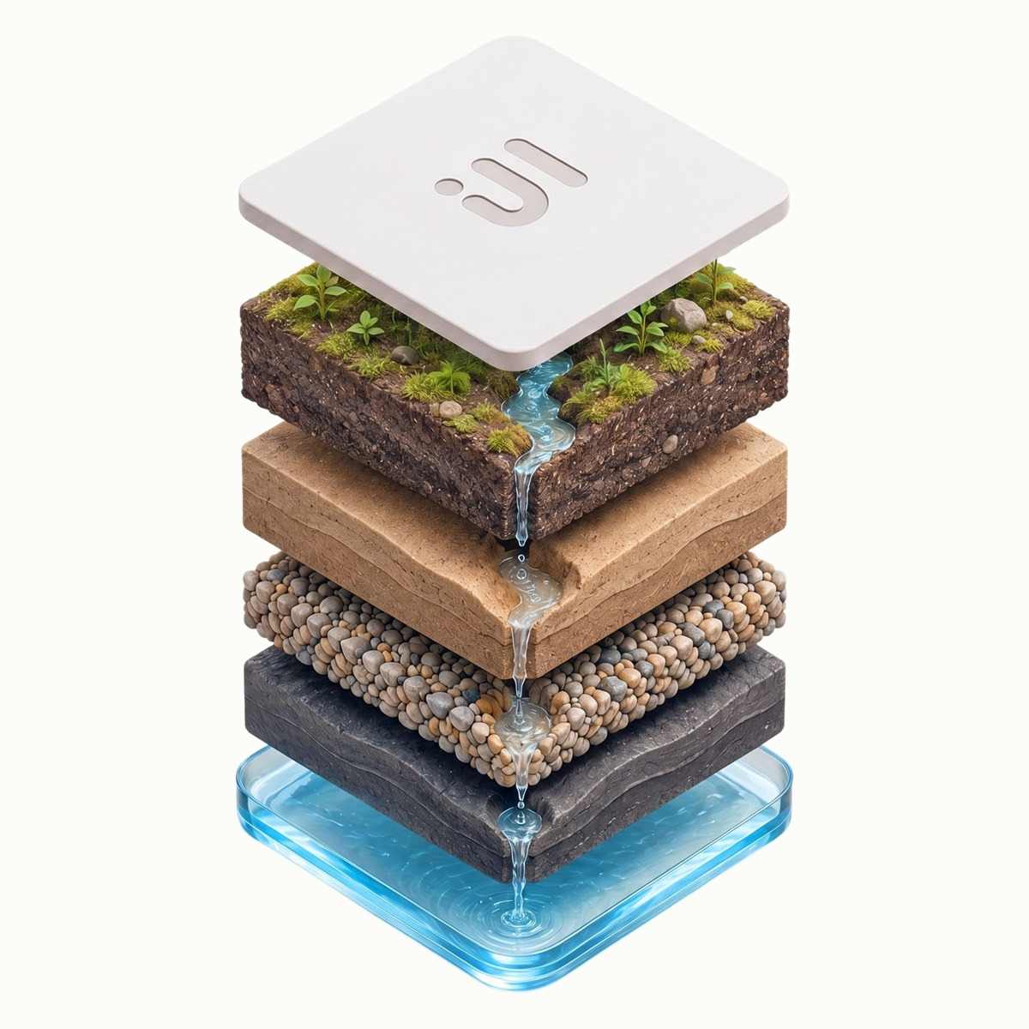
POINTFIVE · 2026 BRAND SYSTEM
Corporate
presentation template
Cream and ink. One typeface. Evidence over adjectives. Duplicate any layout that follows and replace the copy.
Notes:
Master template. Duplicate the closest layout and swap text. Real logo and strata imagery are embedded; replace with kit files when published to pointfive.co/brand/guidelines.

Slide 2

HOW TO USE THIS TEMPLATE
Five rules that keep
any deck on brand
01
Two colors only Cream and ink. The legacy blue is retired.
02
One typeface Switzer, end to end. Sentence case everywhere.
03
Numbers earn the space Make the stat big and semibold.
04
One focal point One bold visual or number per slide.
05
Pull, don’t invent Pull from pointfive.co/brand/guidelines.
02
Notes:
The non-negotiables. Ink slides like this one add contrast — use them for openers, big statements and closes.

Slide 3

AGENDA LAYOUT
What we’ll cover
01
Where we are
Context and the headline number
02
The problem
What the data shows today
03
The approach
How PointFive closes the loop
04
Proof
Results from production
05
Next steps
Owners and timeline
03
Notes:
Numbered agenda. Two-word labels; detail in the description column.

Slide 4
01
Section divider
A one-line standfirst sets up the section. Declarative, specific, two lines at most.
Notes:
Use between major parts. Ink + the isometric strata gives the deck rhythm.

Slide 5
CONTENT LAYOUT · SINGLE COLUMN
Detect deeper. Fix faster.
Govern continuously.
Two engines that work together. Detection reads your environment the way an expert would; remediation writes the pull request, opens the ticket, and tracks it to completion.
Architecture-aware findings, not just CSV exports
Multi-cloud and Kubernetes-native context
Realized-savings tracking, not just projections
05
Notes:
Default content slide. Left-aligned. The hero render is the one bold visual; swap for a product screen or chart.

Slide 6
CONTENT LAYOUT · TWO COLUMN
Two surfaces. One source of truth.
For FinOps
For engineering
A practice that proves savings, not promises. Every finding routes to the owner who can fix it, then tracks back to the committed budget.
Cost as a code-review concern, not a quarterly fire drill. Findings show up in Slack, Jira, and as drafted pull requests against the actual module.
06
Notes:
Comparison or audience split. Pair a cream card with an ink card for contrast.

Slide 7
METRICS LAYOUT
Numbers earn the space
$1.84M
500+
14 min
annualized savings surfaced in one environment
expert optimizations across cloud, K8s, data and AI
to a read-only connection — no agents
07
Notes:
Big numbers on ink for maximum impact. Set the figure huge and semibold.

Slide 8
DATA LAYOUT
Realized savings, booked back to budget
Charts use ink on cream with warm-neutral gridlines.
The product severity palette is reserved for in-product findings — never decorate a chart or slide with it.
08
Notes:
Native editable chart. Single ink series. Keep product severity colors out of marketing.

Slide 9












LOGO & ICON LAYOUT
Already where your stack lives
Vendor marks are the one place color enters a deck — always the real logo, never an emoji or a redrawn glyph.
AWS
Azure
GCP
Kubernetes
Snowflake
Databricks
Slack
Jira
GitHub
Datadog
Bedrock
Karpenter
09
Notes:
Integration / logo wall. The color vendor marks bring legitimate color; everything around them stays cream and ink.

Slide 10
“
PointFive found waste below the dashboard line and made it safe for engineering to act.
Head of Cloud Infrastructure
Nubank
10
Notes:
Customer quote. Customer voice outweighs ours. Attribution in medium weight.

Slide 11
Find your first $1M
in waste in 14 days.
Request a demo · pointfive.co/request-demo
Talk to the team · pointfive.co/talk
Notes:
Closing / CTA. One verb-first action. Bookends the cover.

